Slide 1
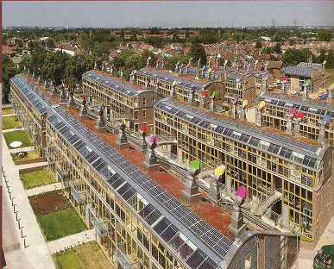
URBANIZATION AND SUSTAINABLE CITIES

Slide 2
Objectives
Distinguish between a rural village, a city, and a mega city.
Recognize the push and pull factors that lead to urban growth.
Report on the growth rate of giant metropolitan urban areas such as Mexico City, as well as problem this growth .
Understand the cause and consequences of urban slump.
Explain the principals of smart growth, green urbanism, and conservation designs.
Evaluate the way that cities can be ecologically, socially, and economically sustainable.

Slide 3
Questions
How many people now live in cities, and how many live in rural areas worldwide?
What changes in urbanization are predicted to occur in the next 30 years, and where will that change occur?
What is the difference between a city and a village and between rural and urban?
Describe the current condition in a typical mega city of the developing world. What force contribute to its growth?
Describe the difference between slums and shantytowns?
How has the transportation affected the development of cities?
Explain the difference between Greenfield and Brownfield development. Why is Brownfield development becoming popular?

Slide 4
URBANIZATION
The transition from an agricultural society to an industrial one is said to urbanization.
Since the beginning of industrial revolution, some 300 years ago, urbanization starts rapidly.
Urbanization and industrial revolution brings many benefits to the humans especially to the top members of the society, but they also cause many problems for humans and environment. e.g. population, pollution etc.

Slide 5
Difference between Rural and urban area
Rural area:-
A rural area is one in which a majority of residents are supported by methods of harvesting natural resources e.g. a village is a rural community.
Urban area:-
An urban area is one in which a majority of residents are supported by manufacturing, commerce, or services. e.g. a city is an urban community.

Slide 6
Why do cities grow?
Urban populations grow in two ways
Natural increase (more births than deaths)
It is fueled by improved food supplies, better sanitation and good medical care. in Latin America and east Asia natural increase is responsible for two-third of urban population growth.
Immigration
Immigration can be caused both by push factors (that force people out of the area) and by pull factors (that draw them into the cities) .in Africa and west Asia immigration is the largest source of urban population.

Slide 7
Urban challenges in the developing world
90% of the human population growth in the next century is expected to occur in the developing world. almost all the growth will occur in cities, which already have trouble supplying food, water, housing, jobs, and basic services for their residents. the unplanned and uncontrollable growth of those cities causes tragic urban environmental problems.
Traffic congestion
Due to the rapid population increase, the traffic problem also increased. the road are too narrow for increasing traffic which result in traffic congestion in these countries. e.g. in Bangkok an average resident spends the equivalent of 44 days a year sitting in traffic jams. About 20% of all fuel is consumed by vehicles standing still. hours of work lost each year are worth of least $3 billion.

Slide 8
Urban challenges in developing countries conti……..
Air pollution
The traffic much of it involving old poorly maintained vehicles, combine with Smokey factories and the use of wood or coal fires for cooking and heating contribute to air pollution. An estimated 60% of Calcutta's residents are thought to suffer from respiratory diseases linked to air pollution.
Water pollution
The disposal of solid waste into water bodies and insufficient sewage treatment causes water pollution in developing countries. e.g. in Latin America where only 2% of urban sewage receives any treatment. some 400 million people in developing world cities do not have safe drinking water.

Slide 9
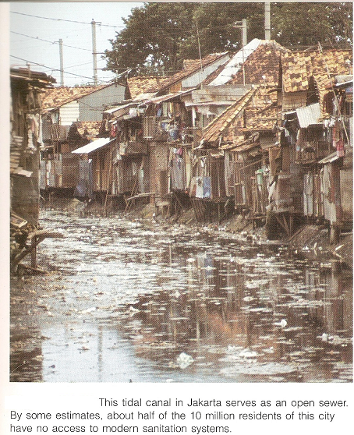

Slide 10
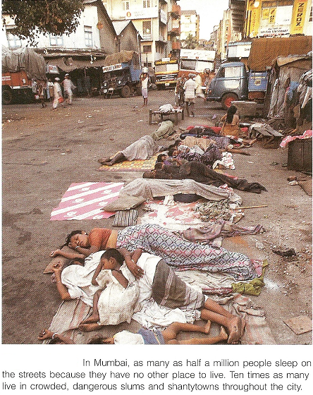
Urban challenges in developing countries conti……..
Insufficient housing
Many cities in developing countries lacks sufficient housing. it is estimated that 1 billion people-20% of the world population live in crowded unsanitary slums or vast shantytowns. Around 100 million people have no home at all.

Slide 11
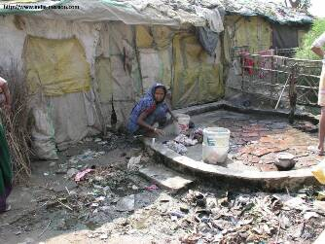
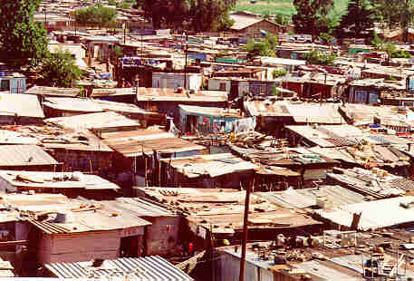
Slums And Shantytown
Slums are inadequate multifamily tenements or rooming houses, either built to rent to poor people or converted from some other uses e.g. Chals of Mumbai.
Shantytowns are settlements created when people move onto undeveloped lands and build their own houses. Shacks are built of corrugated material, discard packing crates, brush, plastic sheets, or any building material people can scavenge.

Slide 12
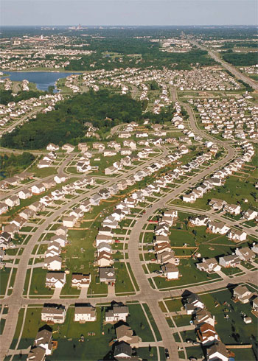
Urban challenges in the developed countries
Urban slump
Cities that once were compact now spread over the landscape consuming open spaces and wasting resources. this pattern of urban growth is known as sprawl. this is the urban challenge in the developed world. sprawl eat up open spaces, it consume thousand of acres of forest and farmland, woodland and wetland because these sprawl cities often are located in fertile river valleys or shorelines, much of that land would be especially valuable for producing crops for local consumption.

Slide 13
Urban challenges in developed countries conti…..
Characteristics of urban spread out (Slump)
Unlimited outward extension.
Low-density residential and commercial development.
Leapfrog development that consume farmland and natural area.
Fragmentation of power among many small units of government..
Dominance of freeways and private automobiles.
No centralized planning or control of land use.
Widespread strips malls and big-box shopping centers.
Decaying city centers as new development occurs in previously rural areas.

Slide 14
Smart growth
Smart growth is a term that describes such strategies for well planed developments that make efficient and effective use of land resources and existing infrastructure.
Goals for smart growth
Create a positive self-image for the community.
Make the city vital and livable.
Solve problems with air, water, toxic waste, and noise pollution.
Improve communication between groups.
Alleviate substandard housing.
Improve community member access to the art.

Slide 15
Thanks To All

